Slide 1
Set Design
What do you HAVE TO HAVE to tell the story?
Strip it down to the bare minimum
Why is a unit set/abstract design good for a Disney movie adaptation?
In the following slides, note the following for each set
How is color and texture used to convey message
How are height/levels used to convey location
How is lighting used to convey information

Slide 2
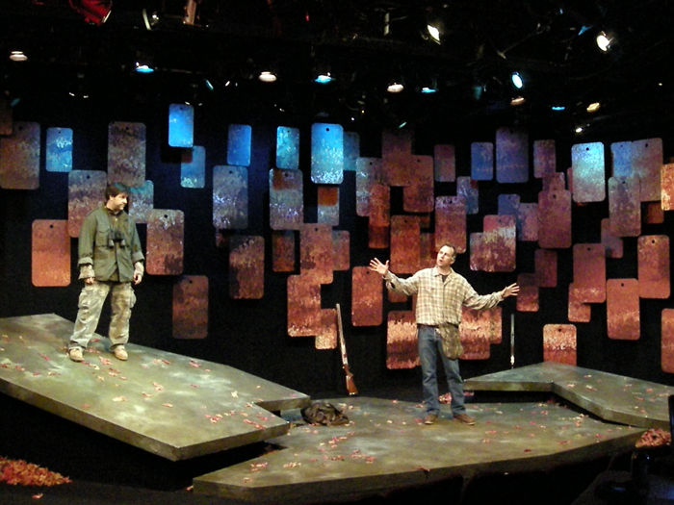

Slide 3
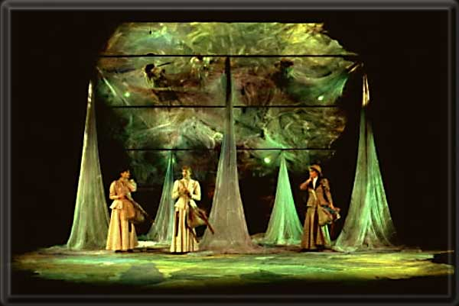

Slide 4
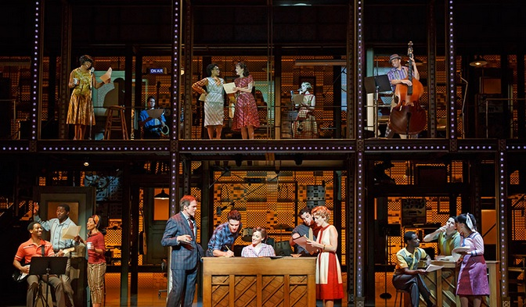

Slide 5
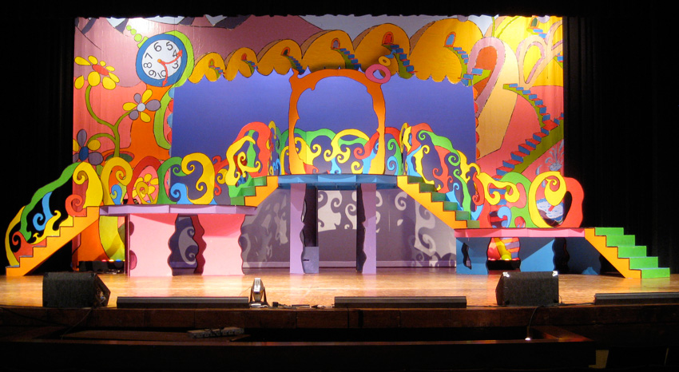

Slide 6
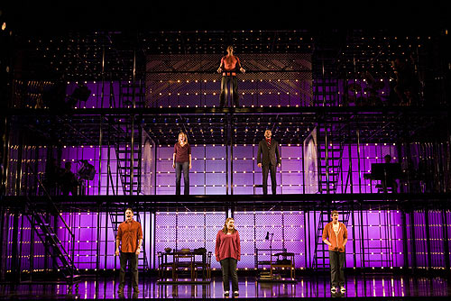

Slide 7
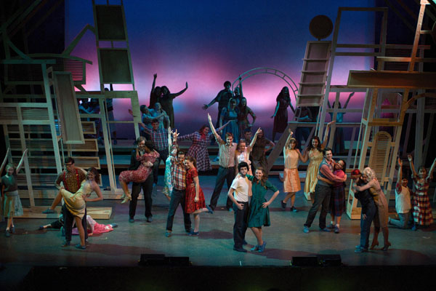

Slide 8
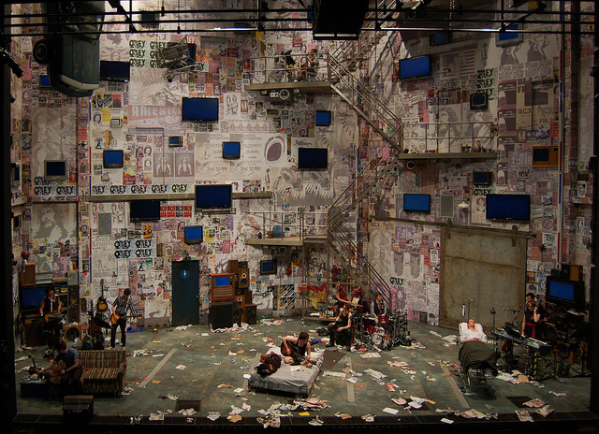

Slide 9
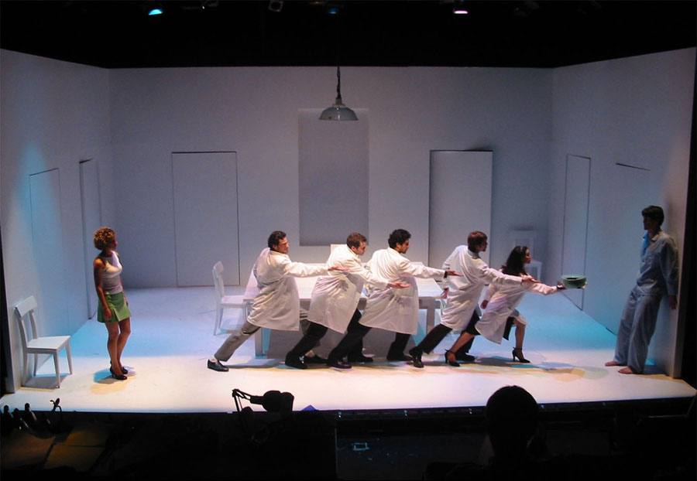

Slide 10
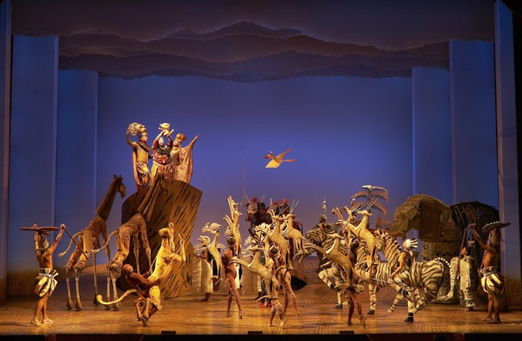

Slide 11
